Slide 1
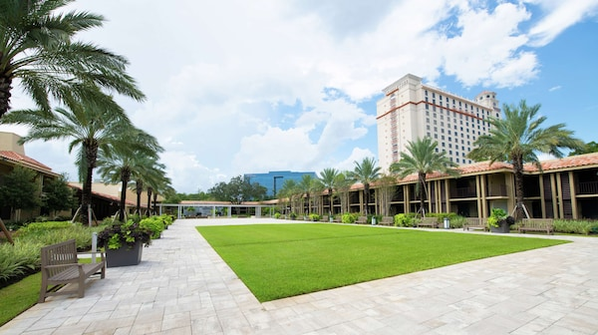
The 76th Southeastern and 81st Southwest Joint Regional Meeting of the American Chemical Society
Orlando, Florida
October 26-29, 2025
SERMACS/SWRM 2025
CHEMISTRY IN THE SUNSHINE
EXHIBITION AND SPONSORSHIP FLYER

Slide 2
You Can Reach Up to 2000 Chemistry Professionals and
May Be More
The Southeastern and Southwest Joint Regional Meeting of the American Chemical Society are conducting a joint technical conference in 2025 for chemical professionals, graduate and undergraduate students.
Between 1500 and 2000 registrations are expected based on past participation and on the attractiveness of the meeting venue.
Orlando, Florida, has been named for the seventh time the Top Meeting Destination for 2024 by Cvent, an industry-leading meetings, events, and hospitality technology provider.

Slide 3
SERMACS Inc. comprises nine southeastern states and one territory of the United States composed of Virginia, Kentucky, Tennessee, North Carolina, South Carolina, Georgia, Alabama, Mississippi, Florida, and Porto Rico.
The Southwest Regional Meeting of the American Chemical Society encompass local sections which lie within or partially within the states of Texas, Oklahoma, New Mexico, Arkansas and Louisiana.

Slide 4
The SERMACS/SWRM conferences attract attendees from various sectors to showcase their work, keep abreast of the latest scientific developments and network.
The preponderance is from academic and government research while specific industry representation depends on a conference’s theme and programming.
Professionals from laboratory equipment, chemicals, educational and literature services showcase their products at these events.
The Joint SERMACS and SWRM conference is an excellent forum for recruiting talent and help aspiring and professionals at all career stage becoming familiarized with your institution or enterprise.
* Without Students and Post-Docs
Demographic data herein reflects attendance at SERMACS 2021 and 2022.

Slide 5
Meeting Venue
DoubleTree by Hilton Hotel Orlando by SeaWorld
10100 International Drive
Orlando, FL 32821
Our regional conference offers an unparalleled environment for exhibitors to showcase their products and network with the professionals associated with the American Chemical Society but in a more intimate setting.
Orlando is situated in the middle of the Florida High-Tech Corridor, expanding from the Suncoast to the Space Coast, with a vibrant community involved in the aerospace, analytical, environmental, material, medical sciences and more.
We plan hosting poster sessions and coffee breaks in the exposition hall to maximize traffic near the exposition booths. We invite you to explore the many other options discussed below to increase your exposure before, during and after the conference.

Slide 6
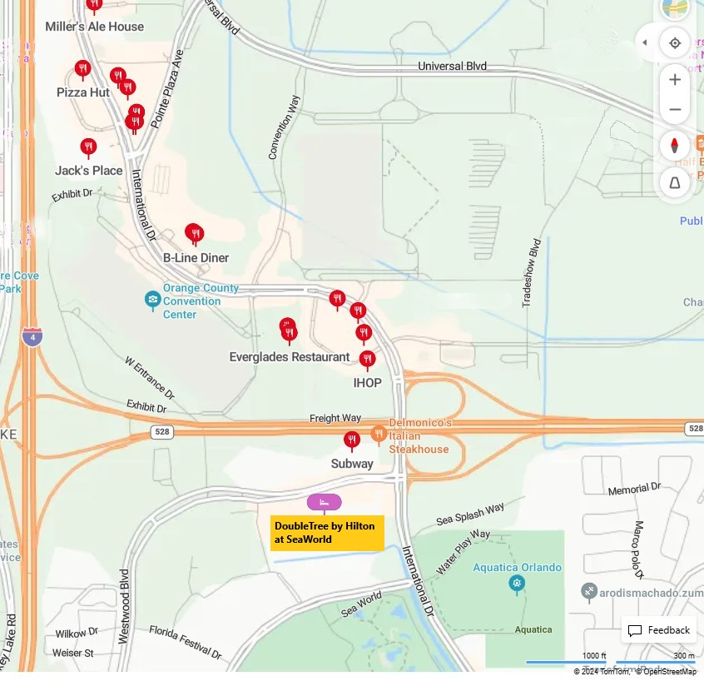
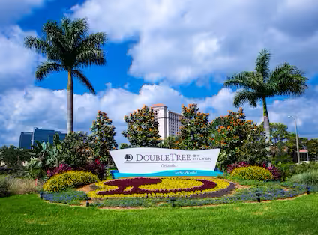
DoubleTree by Hilton Orlando at SeaWorld is conveniently located between the Orange County Convention Center and SeaWorld, and near popular Orlando attractions including Aquatica, Universal Studios Florida, and Walt Disney World theme parks.

Slide 7
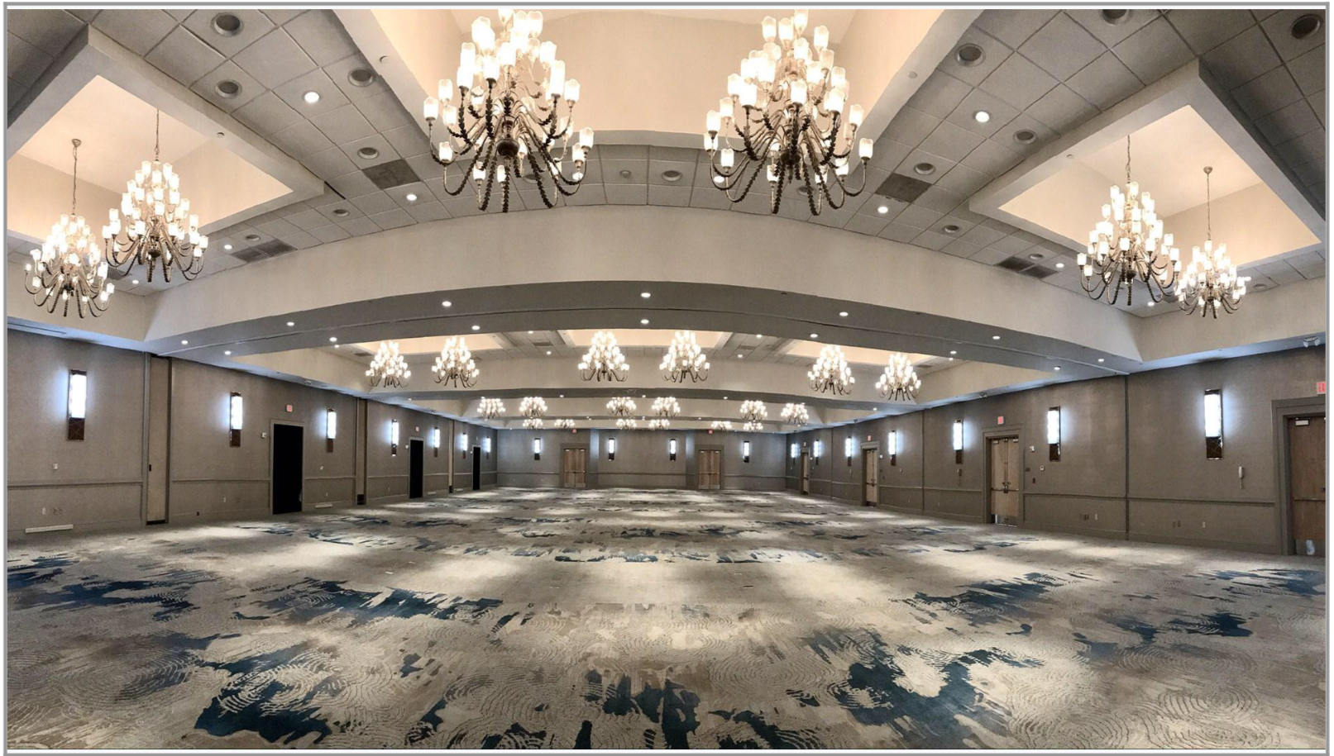
The Conference will occupy the three DoubleTree Hotel conference centers. The Exposition Hall is located in the Majestic Ballroom at the Palm Conference Center.

Slide 8
Exhibit Booth Type | Price | Benefits*
Commercial Oct 27 and 28, 2025 | $1500 ($1700 after Aug 1, 2025) | - Includes a 6ft skirted table, two chairs, one waste basket, one identification sign with booth number and general overhead illumination - Two (2) exhibitor registrations, - Plus the benefits of Tangerine-level sponsorship.
Grad Fair Oct 26, 2025 | $400 ($600 after Aug 1, 2025) | Includes a 6ft skirted table, two chairs one waste basket, one identification sign with booth number and general overhead illumination Two (2) Graduate Fair registration Website and mobile app listing.

Slide 9
Sponsorship
We are grateful to acknowledge your financial contribution to the Regional Meeting on our
Website and in the program
Contributions can take the form of:
Direct monetary contribution
Sponsorship of specific activities
Sponsorship of a specific technical session or of a speaker presentation
The total amount you chose from the Sponsorship, Advertising , and Recruitment categories determines the following level of benefits.
Sunshine | $25,000 +
Grapefruit | $10,000 +
Orange | $5,000 +
Tangelo | $2,500 +
Tangerine | $1,000 +
Key Lime | $500 +
Kumquat | $250 +

Slide 10
Other Advertising Opportunities
OPTION 1- Sidewalk/ Floor Carpet Adhesives $2500/ 5 adhesives. Lead attendees from the main entrance right to your booth with strategically placed adhesives featuring your company ‘s logo and booth number. (Substitution for 2 window adhesives and 3 floor Adhesives available)
OPTION 2- Exhibitor Workshops $1500/hour (limited opportunities available) Looking to educate our attendees about how your company or institution can help resolve their biggest dilemmas? Host an informative workshop in one of our conference rooms. Theater is located in our exhibit room. Hurry- sessions slots are extremely limited!

